Slide 1
Module 1: Week 1 Report
Audio signal processing and speech recognition
Anny & Thomas

Slide 2
Noise
Procedure:
Modified RealTimeAudioSetup script
Ran FFT and PSD on final measured audio signal
Determined noise

Slide 3
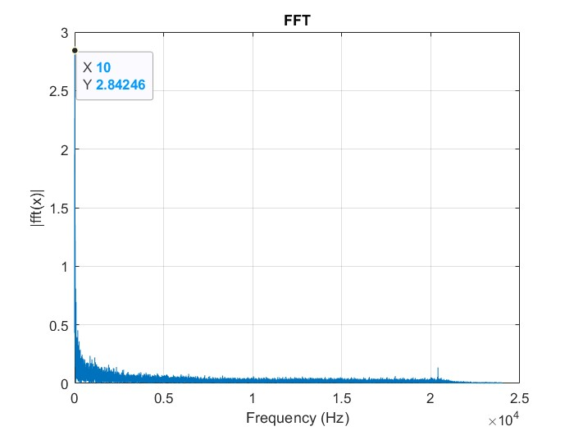
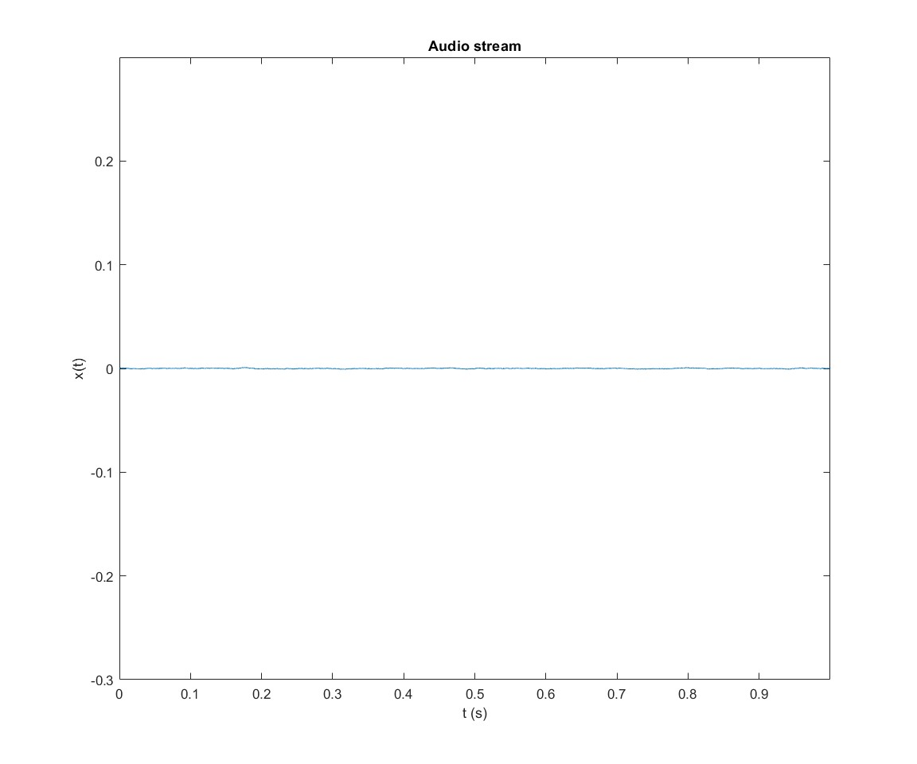
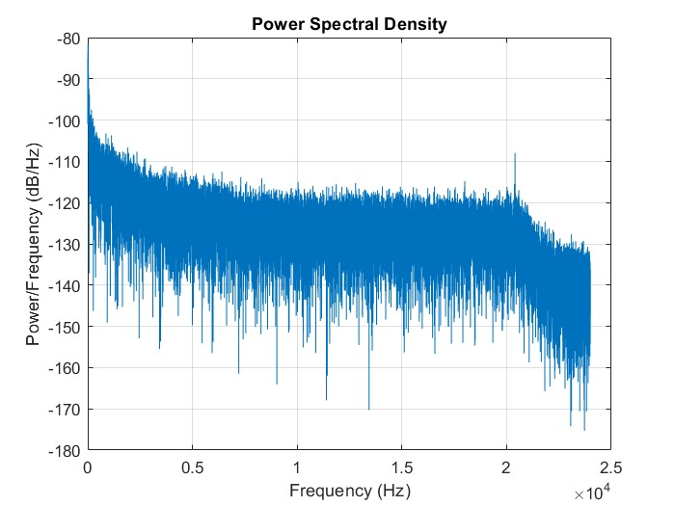
Noise: Audio Card (no connections)
Small Noise
Very small PSD

Slide 4
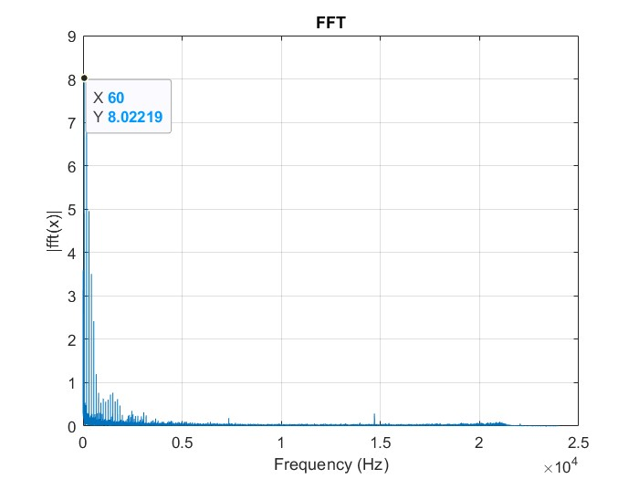
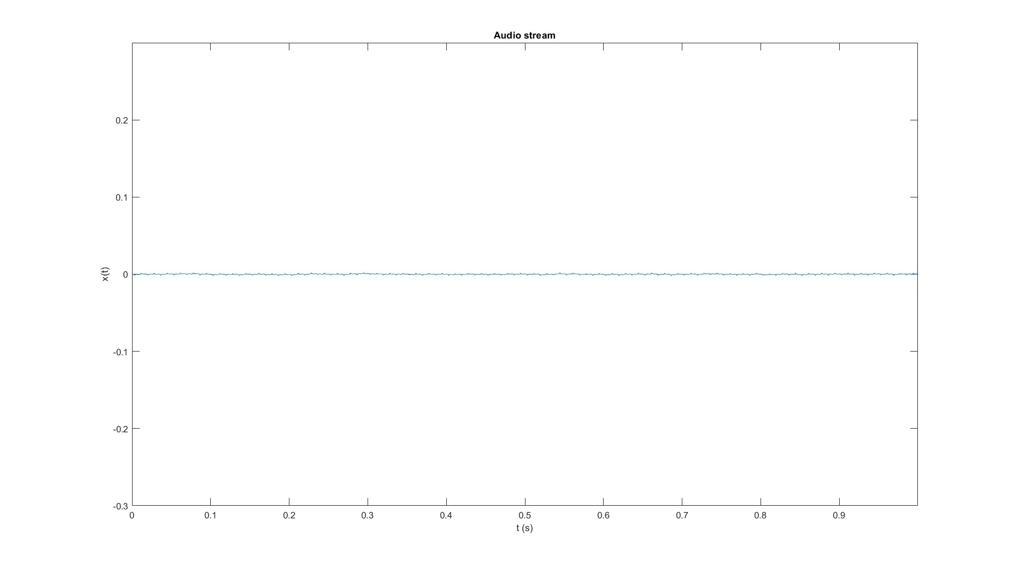
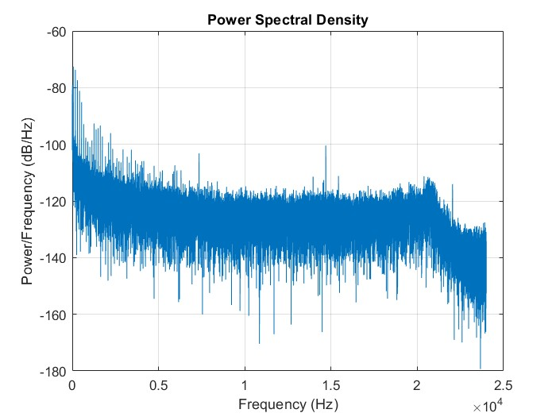
Noise: Loopback
Small periodic triangle noise
Small PSD, larger than before
More signal

Slide 5
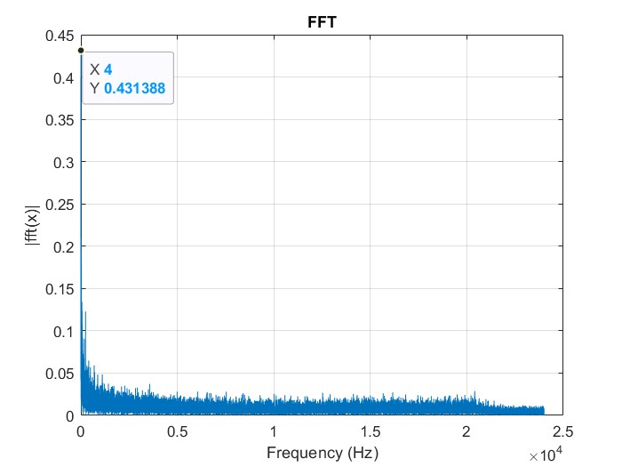
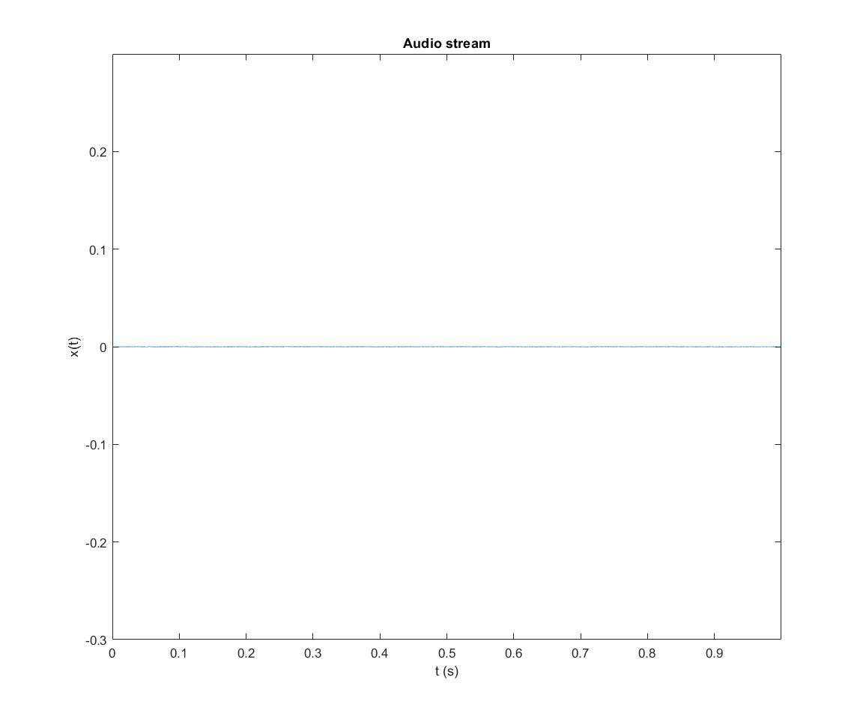
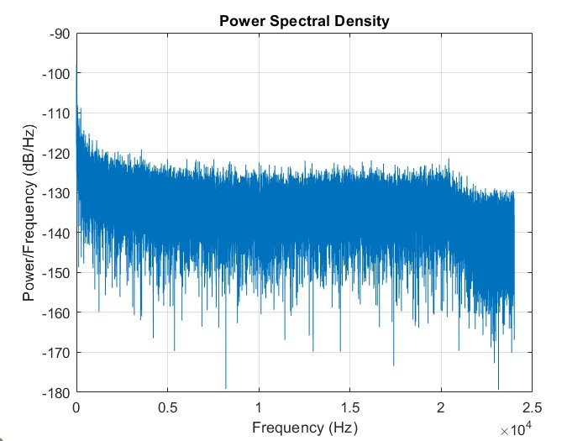
Noise: Room Audio
Using Apple Earbuds
Less noise in signal
Maybe better mic filter
Smaller PSD

Slide 6
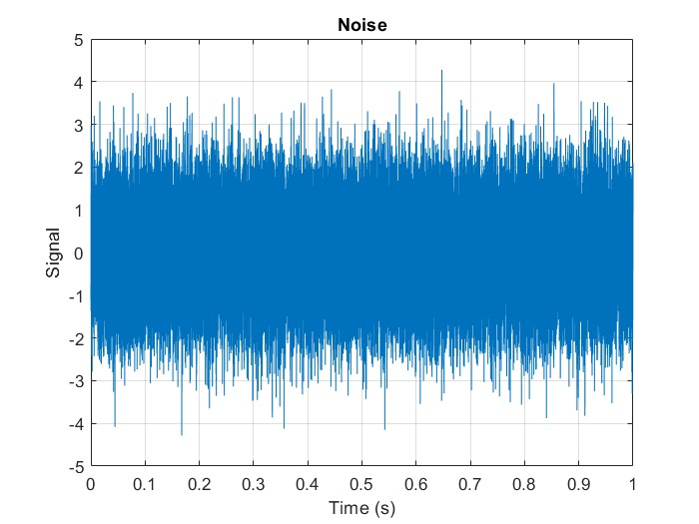
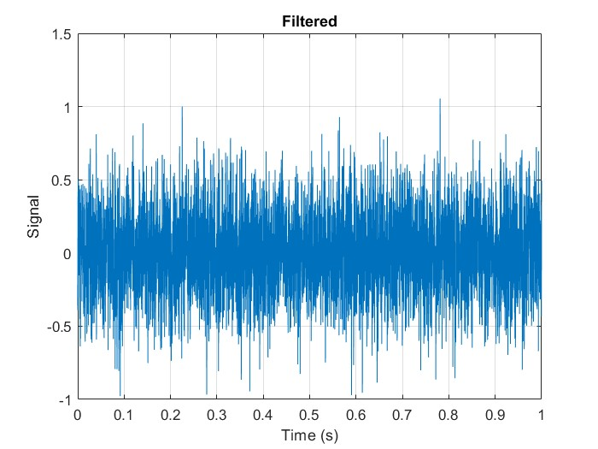
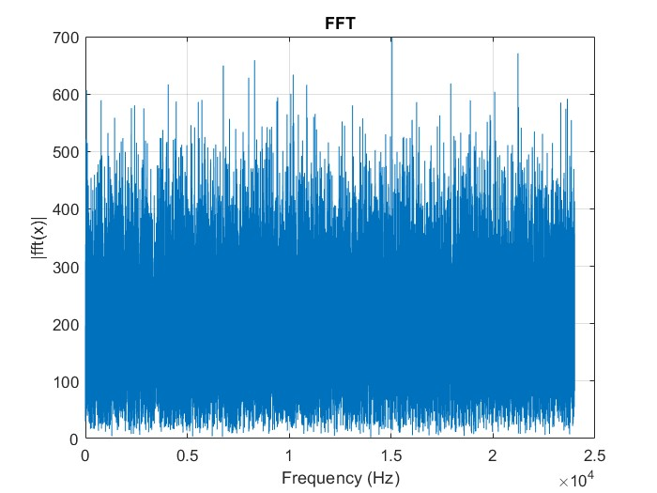
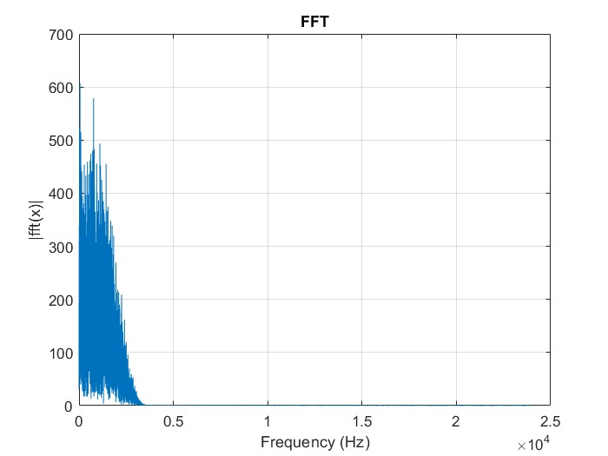
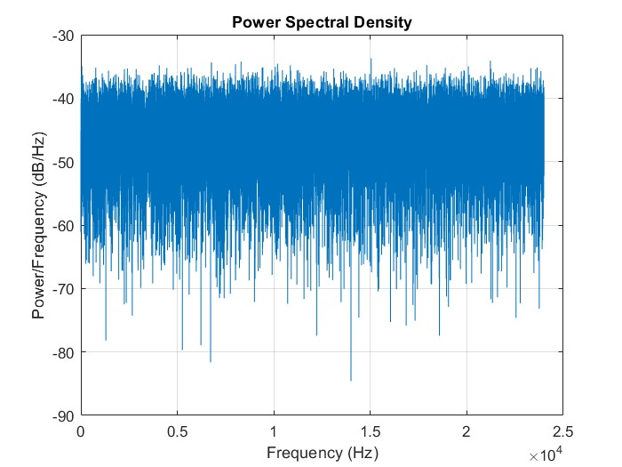
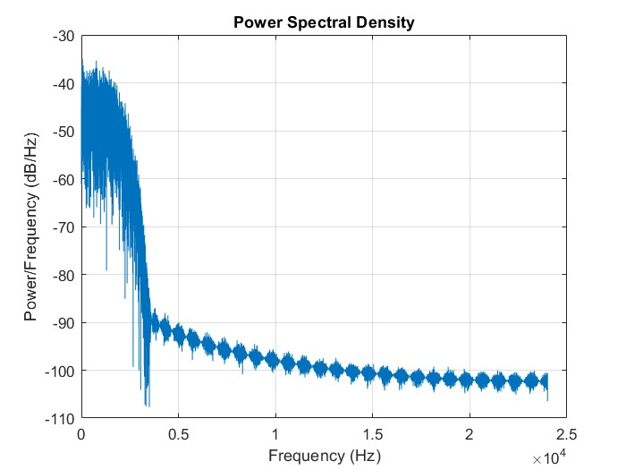
Noise: White Gaussian
Low Pass filter applied
FFT cuts off at high frequency
PSD also shows cut off for high Hz

Slide 7
System Frequency Response
Procedure:
Modified audioLatencyMeasurementExampleApp
Ran audio, measured signal received
Plotted FFT and PSD
If not noted otherwise the samples/frame is 1024 and the sampling frequency is 96000.

Slide 8
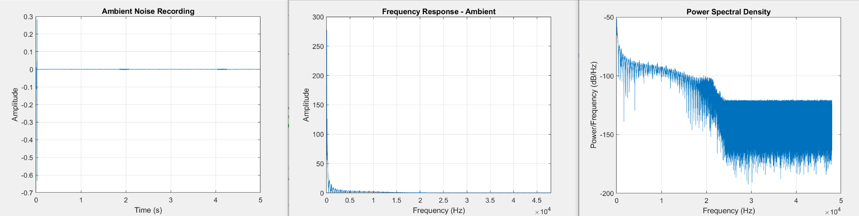
System Frequency Response: No Input

Slide 9
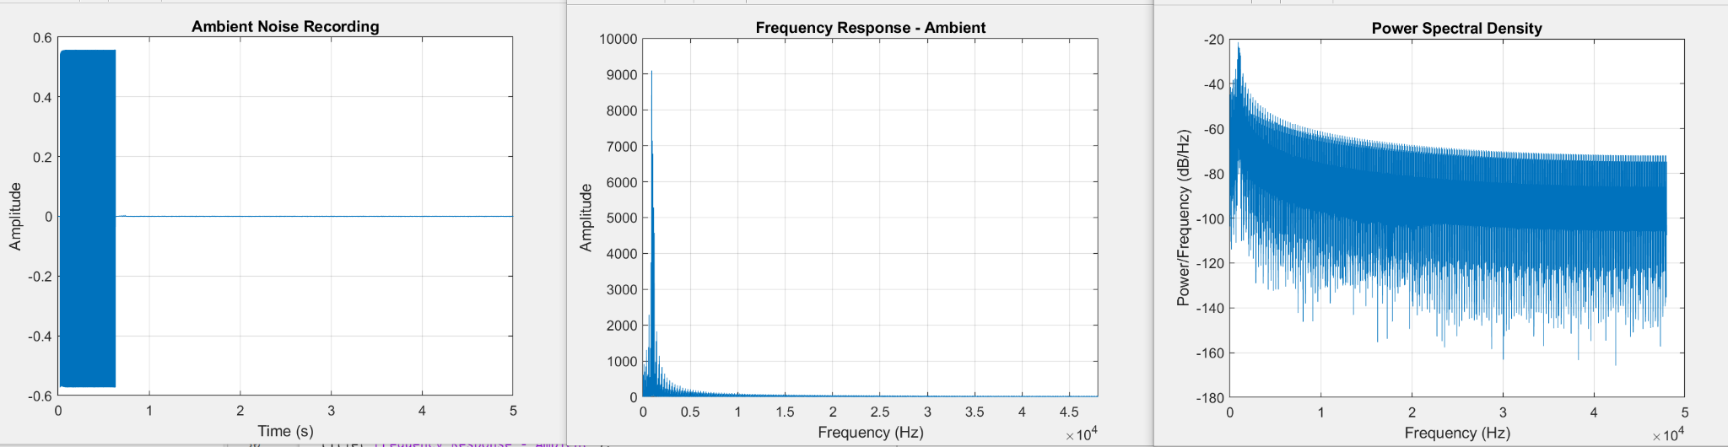
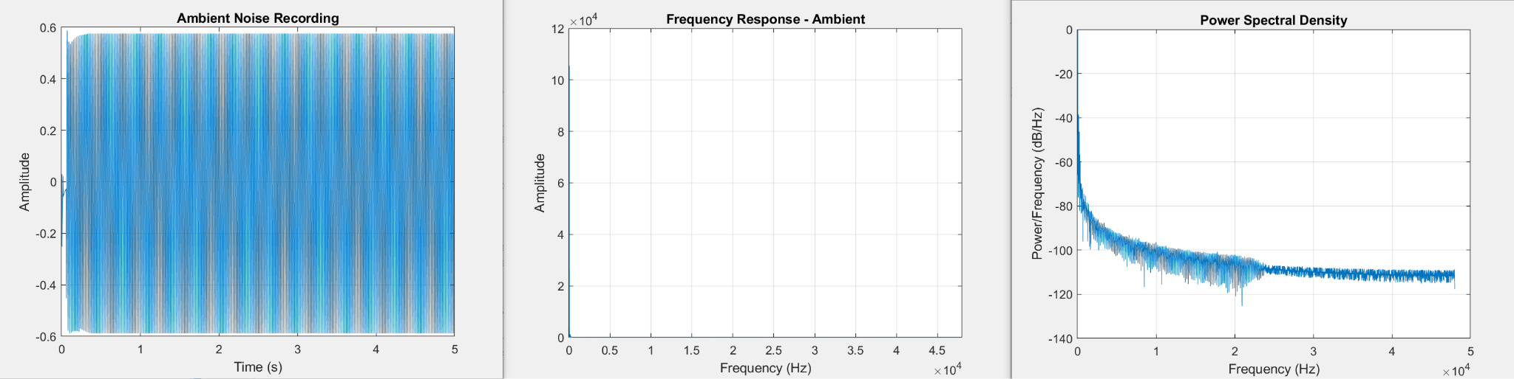
System Frequency Response: Sine Wave
samples/ Frame = 32
Freq =1000
samples/ Frame = 1024
Freq =50

Slide 10
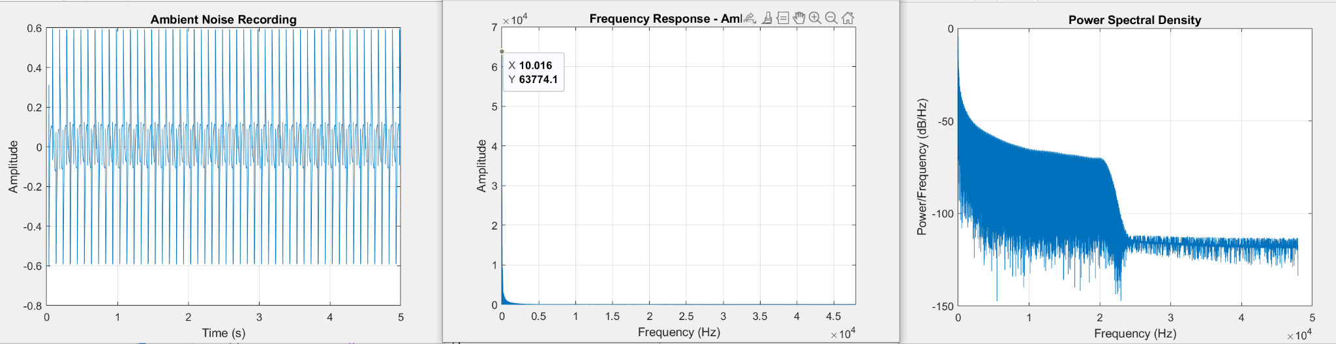
System Frequency Response: Square Wave
Freq = 10

Slide 11
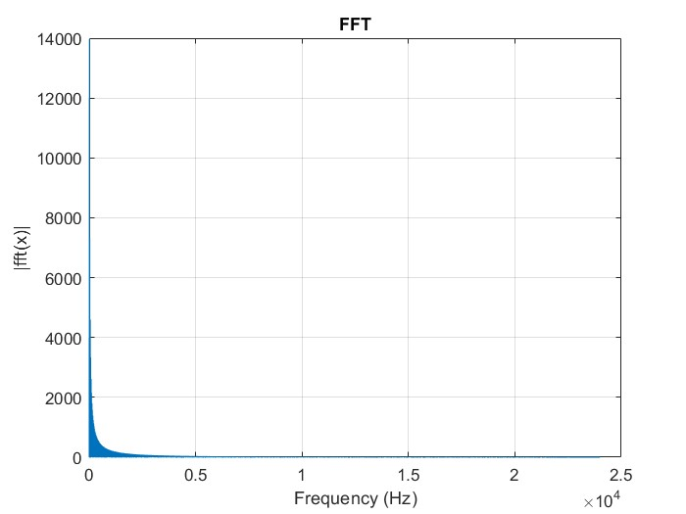
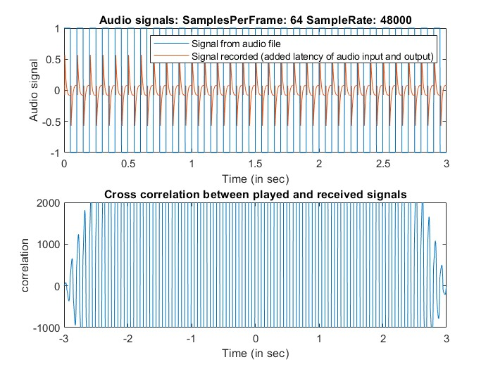
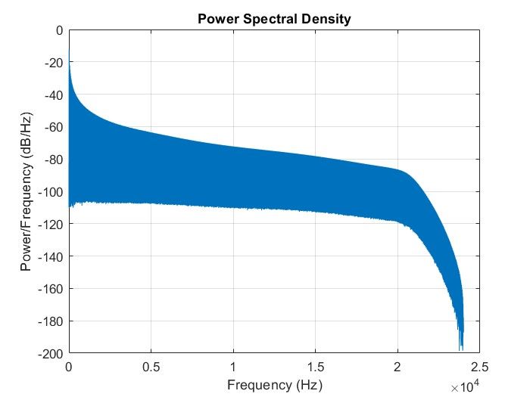
System Frequency Response: Square
10Hz square wave, different hardware
Sound card does not pick up entire square wave

Slide 12
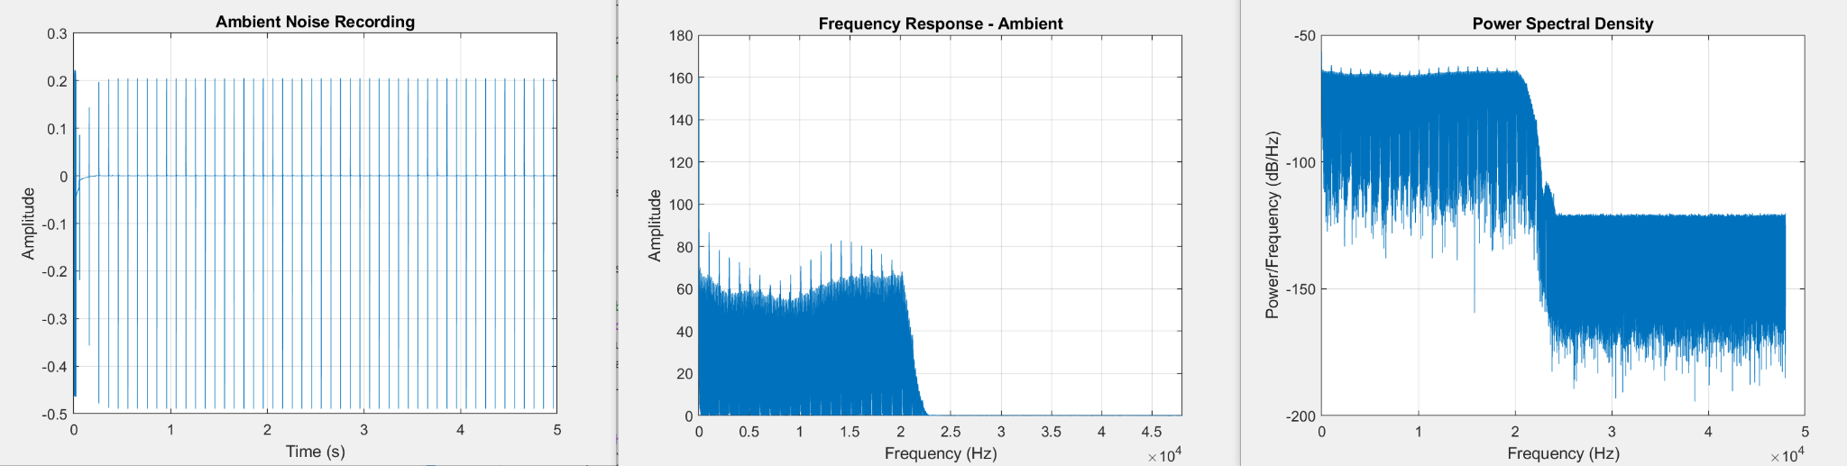
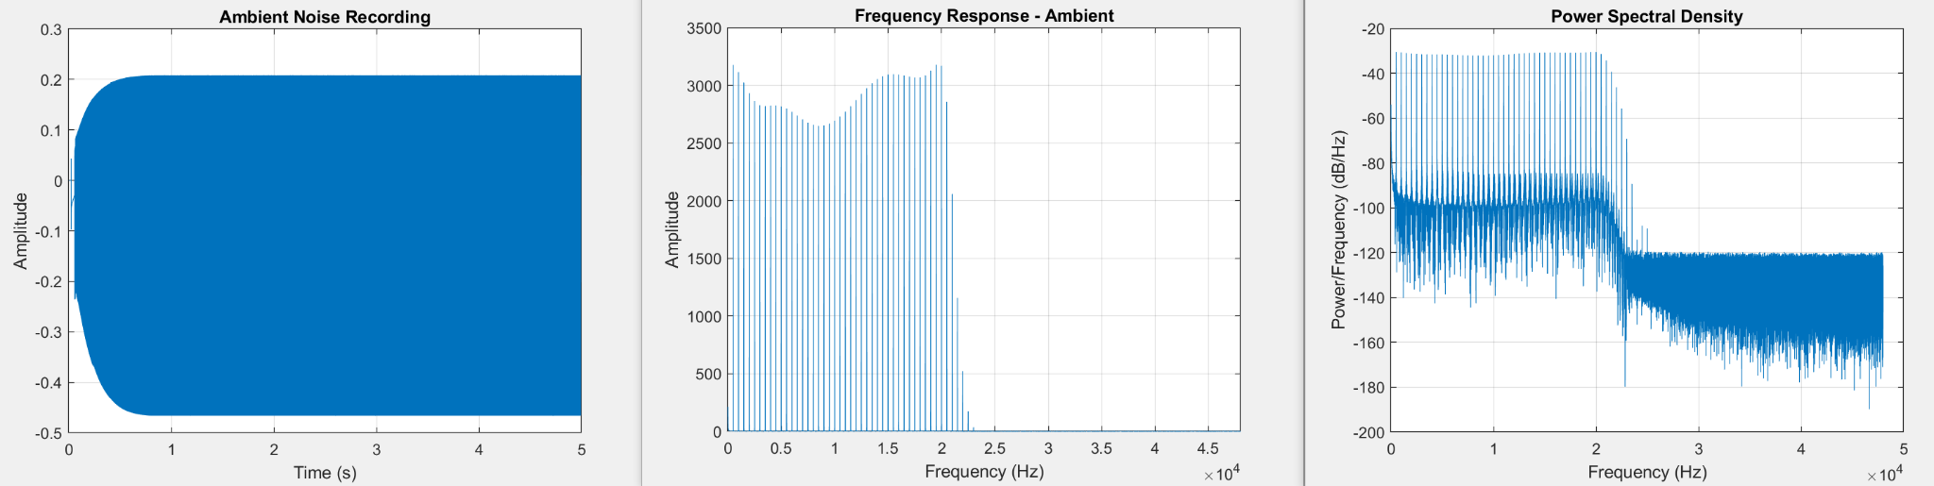
System Frequency Response: Impulse Train
Freq = 10
Freq = 500

Slide 13
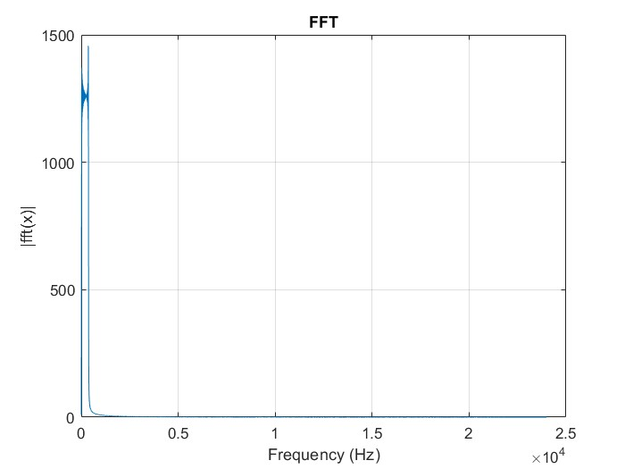
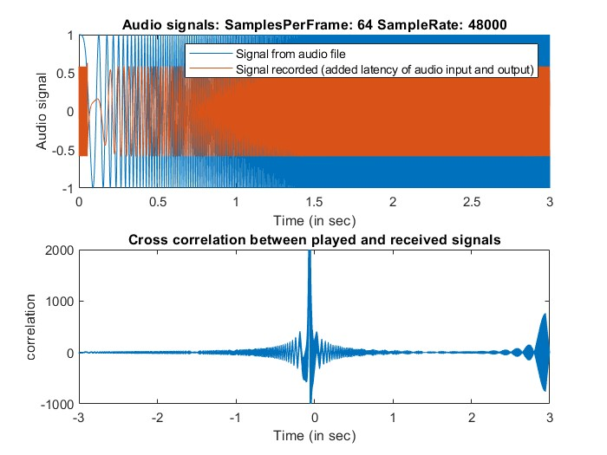
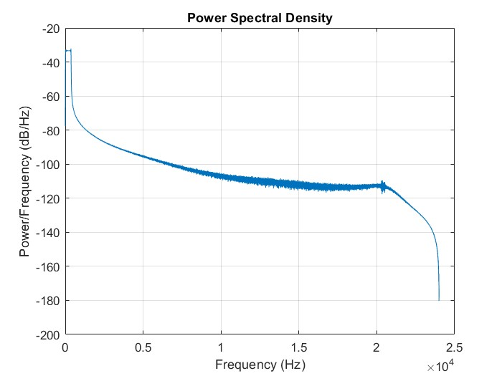
System Frequency Response: Chirp
Chirp increases from 0Hz to 250Hz in 2s
Can see the frequency has more power in lower Hz

Slide 14
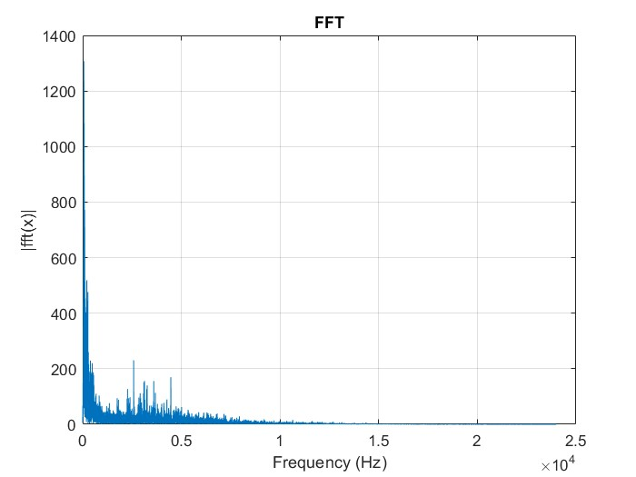
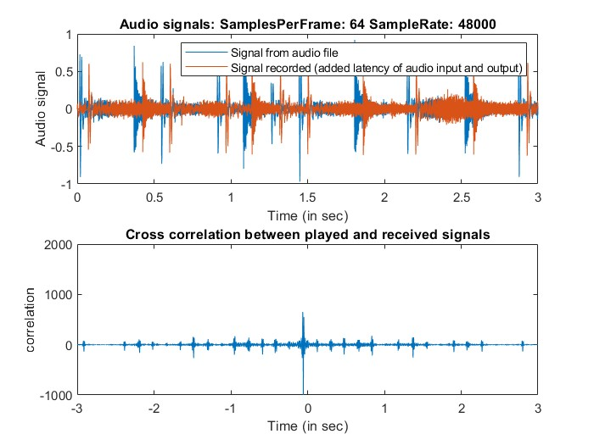
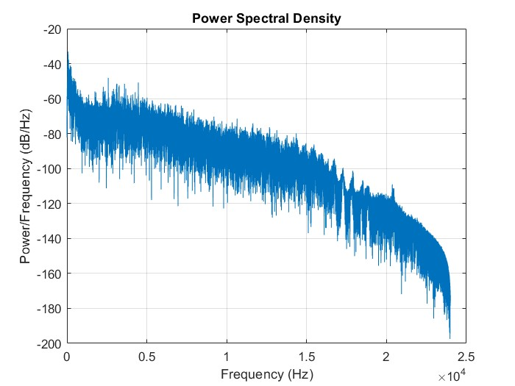
Frequency Response: Drum
A lot of low frequency signal

Slide 15
Latency
Procedure:
Measured latency while changing parameters such as samples per frame, sample rate, etc to find how to get lowest latency

Slide 16
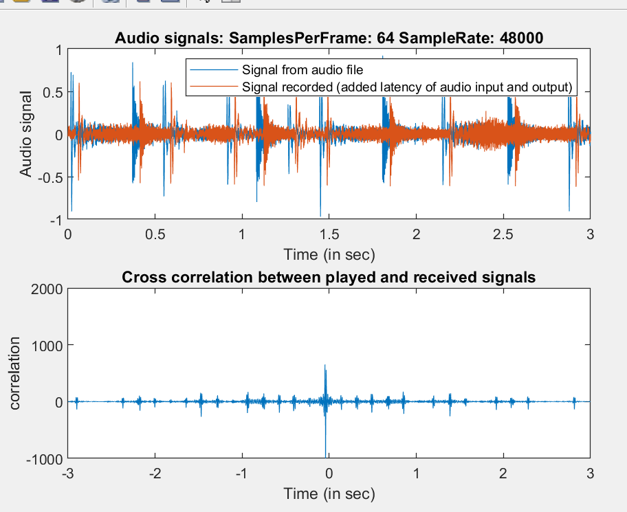
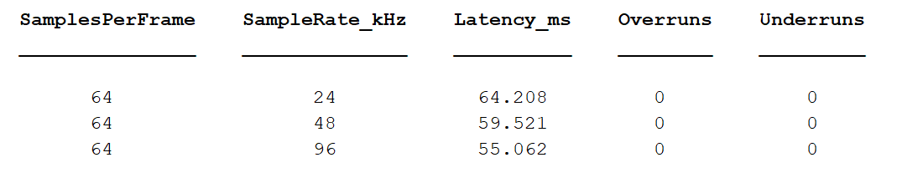
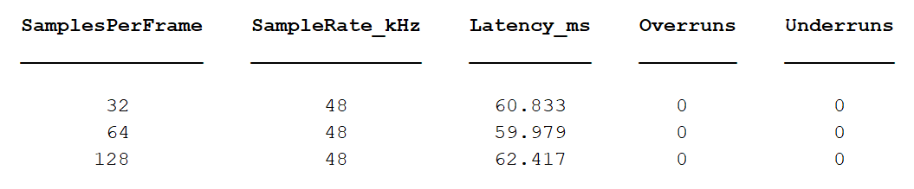
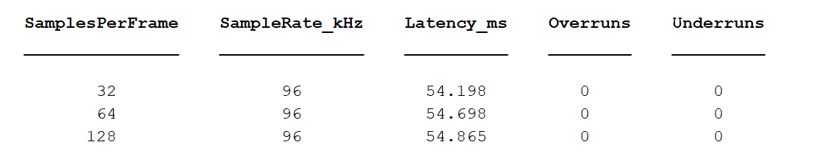
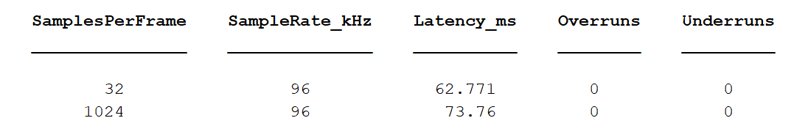
Latency: Loop Back

Slide 17
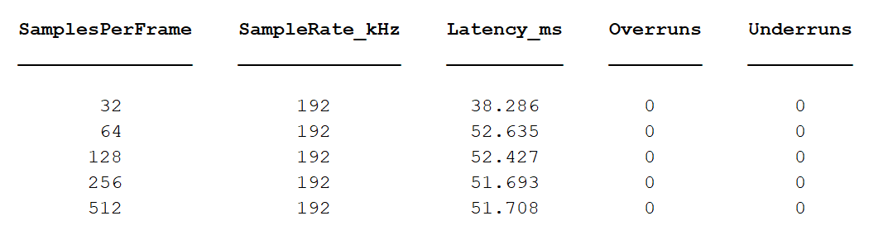
Higher sample rate and lower samples per frame created lowest latency

